Slide 1
Chapter 5
Transportation Problem

Slide 2
Reading
Chapter 5 (Sections 5.1,5.2 and 5.3) of Operations Research, Seventh Edition, 7th Edition, by Hamdy A. Taha, Prentice Hall

Slide 3
Lecture Objectives
At the end of the lecture, each student should be able to:
  Given a situation, identify when the transportation algorithm can be applied
  Understand the basics of the transportation algorithm
  Generate a basic feasible solution for the transportation problem

Slide 4
The Transportation Problem
The transportation problem is a special case of an LP problem
Because of its characteristics, the transportation problem can be solved very efficiently with a special algorithm called the transportation algorithm
The problem is concerned with specifying how to disposition a single product from several sources to several destinations at minimum cost
m Sources
C₁₁: X₁₁
n Destinations
a₁
b₁
a₂
b₂
Demand required from by destination n
Supply Capacity from source m
a_{m}
b_{n}
C_{mn}: X_{mn}
Cost to send a unit from m to n
Number of units to send from n to m

Slide 5
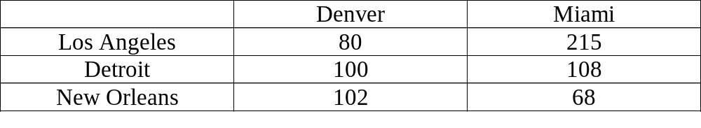
Car-Distribution Problem (from Taha)
The MG Auto Company has plants in LA, Detroit, and New Orleans. Its major distribution centers are located in Denver and Miami. The capacities of the three plants during the next quarter are: 1000, 1500, and 1200 cars. The quarterly demands at the two distribution centers are 2300 and 1400 cars. The cost of shipping in $’s per car is given by:
Find the best strategy to send cars from the plants to the distribution centers.

Slide 6
Model of the Car Distribution Problem
Example: The car distribution problem
Let X_{ij} = units sent from location i (L,N,D) to destination j (V,M).
Then, the problem can be stated as:
  Minimize z = 80X_{LV} + 215X_{LM} + 100X_{DV}+ 108X_{DM}+102X_{NV}+68X_{NM}
  Subject to:
  X_{LV} + X_{LM} = 1000
  X_{DV}+ X_{DM} = 1500
  X_{NV}+ X_{NM} = 1200
  X_{LV} + X_{DV} + X_{NV} = 2300
  X_{LM} + X_{DM} +X_{NM} = 1400
  X_{LV} , X_{LM} , X_{DV} , X_{DM} , X_{NV} , X_{NM}≥0

Slide 7
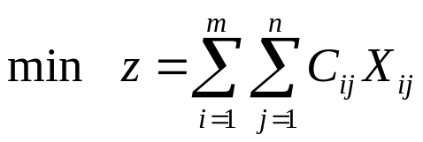
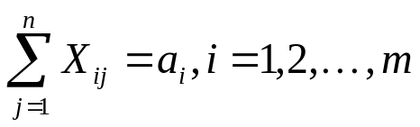
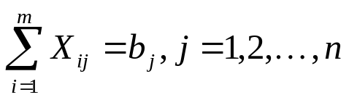

The General Transportation Problem
In general, a transportation problem can be expressed as:
  Subject to:

Slide 8
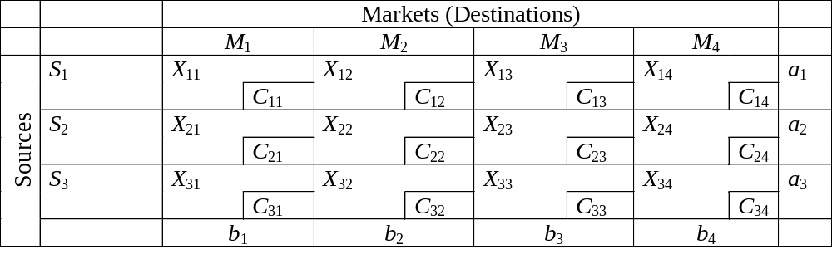
Transportation Tableau
Usually, it is not necessary to explicitly build the LP model of the transportation problem. Instead, we usually represent the transportation problem by using a transportation tableau
Decision Variable
Number of units required in destination 1 (j)
Cost for sending a unit from 3 (i) to 1 (j)
Number of available units to ship from source 3 (i)

Slide 9
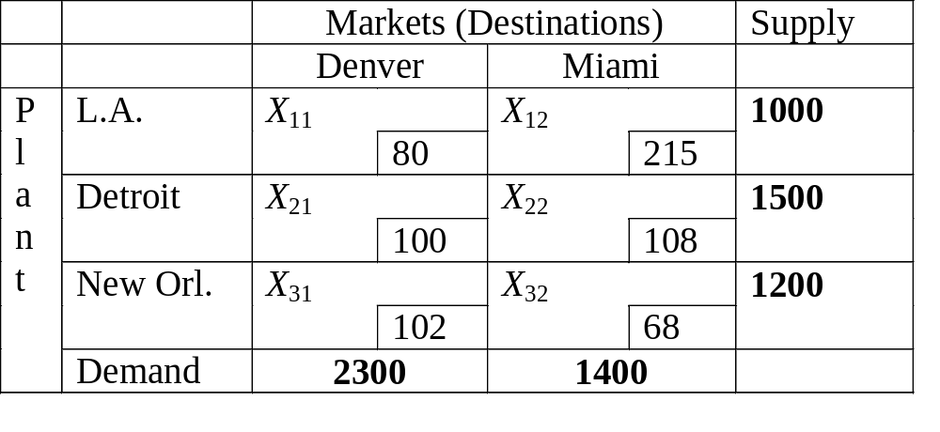
Transportation Tableau Example
Example: Car Distribution Matrix
Min z = 80 X11 + 215 X12 + 100 X21 + 108 X22 + 102 X31 + 68 X32
X11 + X12 = 1000 (LA)
X21 + X22 = 1500 (Detroit)
X31 + X32 = 1200 (New O.)
X11 +X21 + X31 = 2300 (Denver)
+ X12 + X22 + X32 = 1400 (Miami)

Slide 10
Characteristics of the Transportation Problem
The transportation problem could be solved using the regular simplex method. However, because of its special characteristics, a more efficient procedure is used. The procedure is called the transportation (simplex) method.
Because of the uni-modularity property (special structure of the constraints), transportation problems with supplies and demands given by integers will have integer basic solutions.
The transportation problem is solved in two phases:
    1. Determination of an initial basic feasible solution
    2. Finding an optimal solution through the sequential improvement of the initial feasible solution

Slide 11
Finding an Initial Basic Solution
There are many ways to find a feasible solution. We will examine several below. The first is simple but ineffective, and we will then look at more complex but effective (producing near optimal solutions) methods.
Northwest Corner Rule (NWC)
  We begin in the Northwest (upper-left) corner of the matrix and assign as much as we can (considering supply and demand) and update remaining supply and demand. We move either down or to the right (depending on whether supply or demand has been depleted). We again assign as much as possible and continue to the Southeast (lower-right).

Slide 12
Northwest Corner Rule (NWC)
Step1. Allocate as much as possible to the selected cell, and adjust the associated amounts of supply and demand by subtracting the allocated amount.
Step2. Cross out the row or column with zero supply or demand. If both a row and a column net to zero simultaneously, cross out one only, and leave a zero supply (demand) in the uncrossed-out row (column).
Step3. If exactly one row or column is left uncrossed out, stop. Otherwise, move to the cell to the right if a column has just been crossed out or below if a row has been crossed out. Go step 1

Slide 13
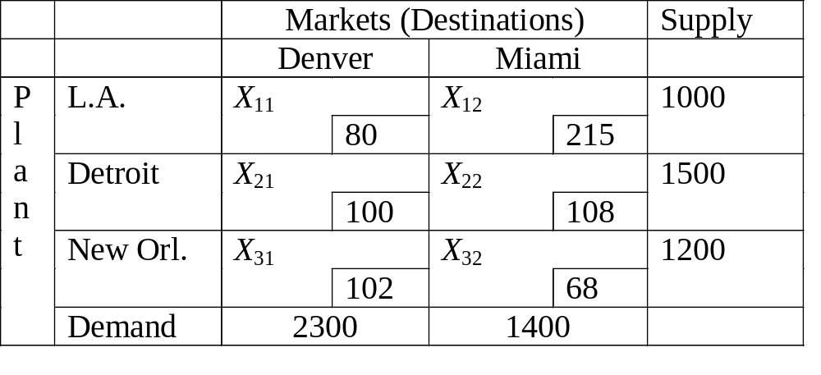
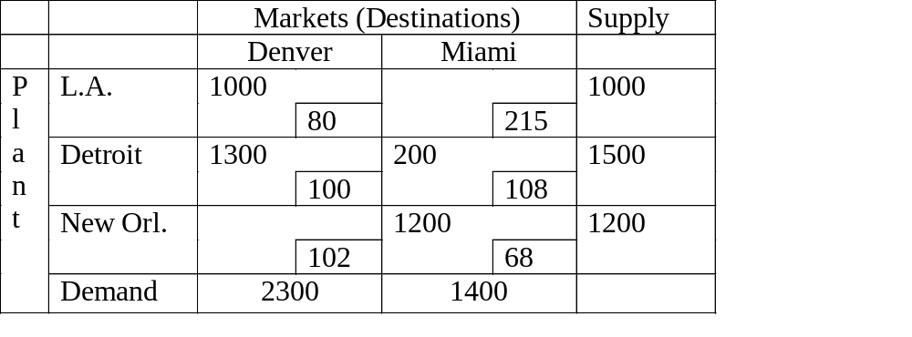
Example of NW Corner
TC=313,200

Slide 14
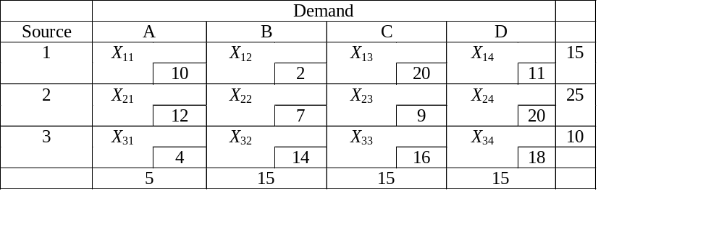
Example 2 of NWC
Using the NW corner rule, make the initial assignment for the following transportation problem
the starting basic solution are:
  X11=5, X12=10;
  X22=5, X23=15, X24= 5
  X34= 10
the association cost is
z= 5* 10 + 10*2+ 5*7+15*9+ 5*20 + 10*18 = $520

Slide 15
The Least Cost Rule (LCR)
Note that the NWC method did not look at the costs! Thus it may produce a terrible solution. The Least Cost Rule examines the costs to build an initial solution. The cell with the lowest cost is chosen, and we assign as many units as possible to the cell (considering supply and demand). We then reduce supplies and demands by the assignment and mark out ineligible cells (those in rows or columns where the supply or demand has been depleted). We repeat this process until all supplies and demands are depleted.

Slide 16
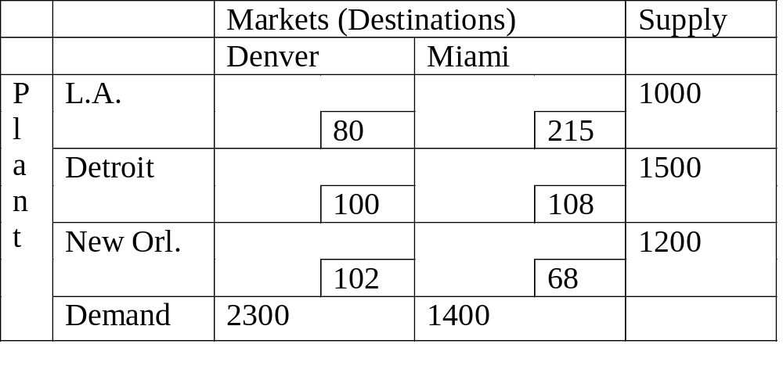
Example LCR
1000
0
1300
200
200
0
1200
0
Least Cost
1300
200
0
0
TC=313,200
Least Cost

Slide 17
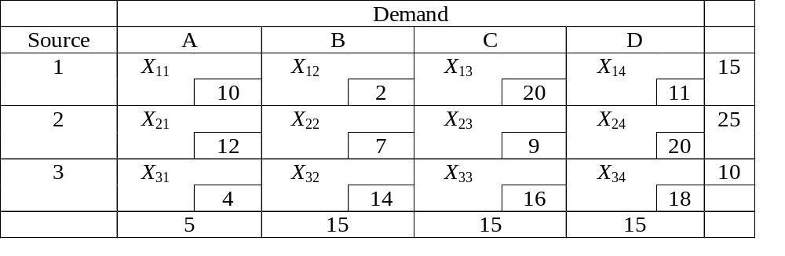
Example 2 of LCR
Using the LC Rule, make the initial assignment for the following Transportation Problem
15
0
0
15
10
10
0
5
5
5
0
0
0
0
10
0
Least Cost
Least Cost
Least Cost
Least Cost
Least Cost
Least Cost

Slide 18
Example 2 of LCR (cont.)
the starting basic solution are:
  X12=15; X14=0;
  X23=15; X24=10;
  X31= 5 X23=5
the association cost is
z= 15* 2 + 0*11+ 15*9+10*20+ 5*4 + 5*18 = $475
15
0
15
10
5
5

Slide 19
Vogel's Approximation Method (VAM)
This method recognizes that it may be wise to make a small sacrifice for a bigger gain. It computes a penalty for each row and column if the lowest cost cell is not selected. That is, it figures out what it would cost to take the second best cost.
The penalty is the cost difference between the lowest cost cell and next lowest cost value in each row and column.
We select the cell associated with the largest penalty to assign units to, and proceed essentially like the LCR. We will have to recalculate some of the penalties on each iteration.

Slide 20
Vogel's Approximation Method (VAM)
Step 1: Determine the difference between the lowest two cells in all rows and columns, including dummies.
Step 2: Identify the row or column with the largest difference. Ties may be broken arbitrarily.
Step 3: Allocate as much as possible to the lowest-cost cell in the row or column with the highest difference. If two or more differences are equal, allocate as much as possible to the lowest-cost cell in these rows or columns.
Step 4: Stop the process if all row and column requirements are met. If not, go to the next step.
Step 5: Recalculate the differences between the two lowest cells remaining in all rows and columns. Any row and column with zero supply or demand should not be used in calculating further differences. Then go to Step 2.

Slide 21
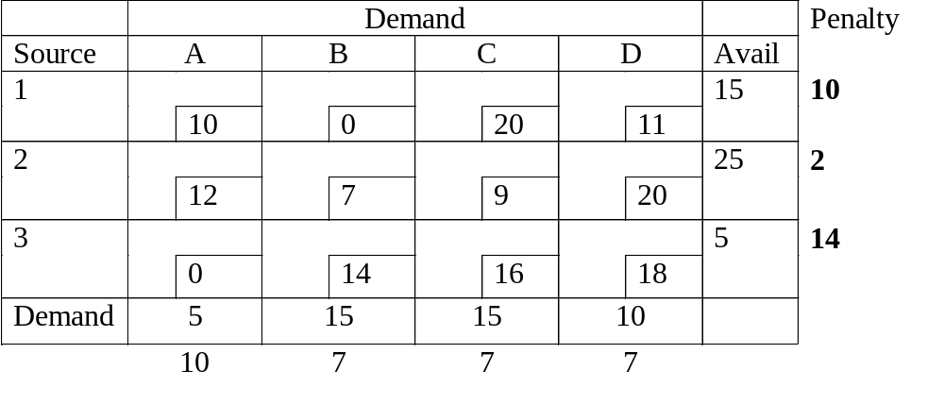
VAM
When this assignment is made, we deplete both the column and the row; however, we eliminate just one. In this case, we arbitrarily eliminate the row
15
0
0
0
15
10
5
Highest Penalty
10
5
0
0
0
0
0
2
11
9
Highest Penalty.
When this assignment is made, we deplete both the column and the row; however, we eliminate just one. In this case, we arbitrarily eliminate the row

Slide 22
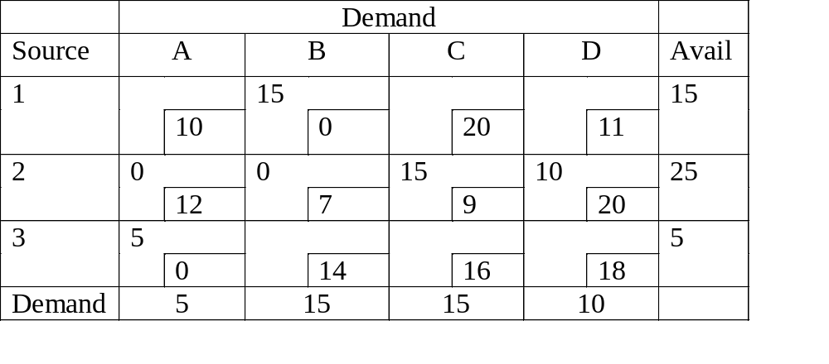
VAM Final Solution
TC = 335

Slide 23
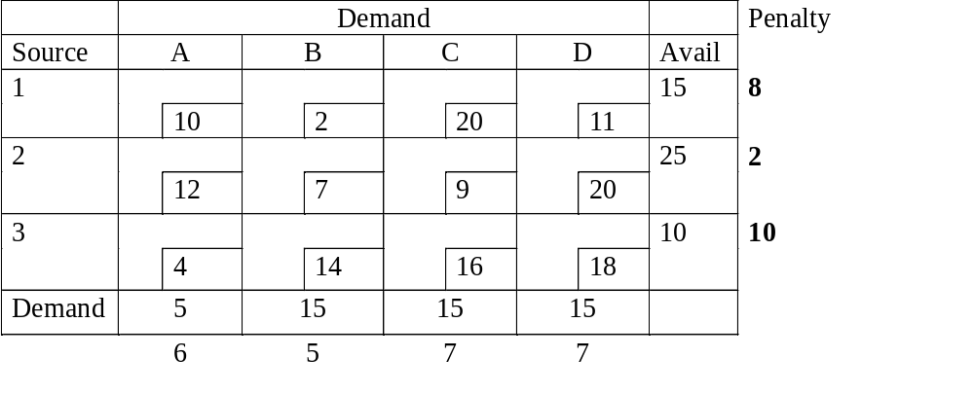
Example 2 of VAM
the starting basic solution are:
  X12=15; X14=0;
  X23=15; X24=10;
  X31= 5 X23=5
the association cost is
z= 15* 2 + 0*11+ 15*9+10*20+ 5*4 + 5*18 = $475
Highest Penalty
15
0
9
Highest Penalty
0
10
11
Highest Penalty
15
10
5
5
5
2
0
0
0
0
10
The solution happens to have the same objective value as in LCR

Slide 24
Dealing with Unbalanced Problems
If the problem is unbalanced (demand and supply are not equal), the problem can be transformed into a balanced one by creating dummy sources or destinations with a cost of zero (usually). These dummy nodes will absorb the difference between the supply and demand.

Slide 25
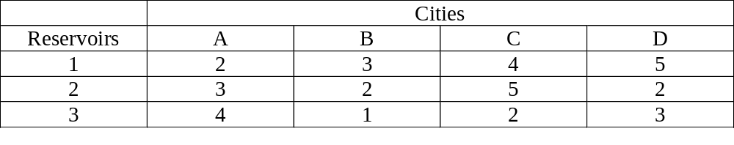
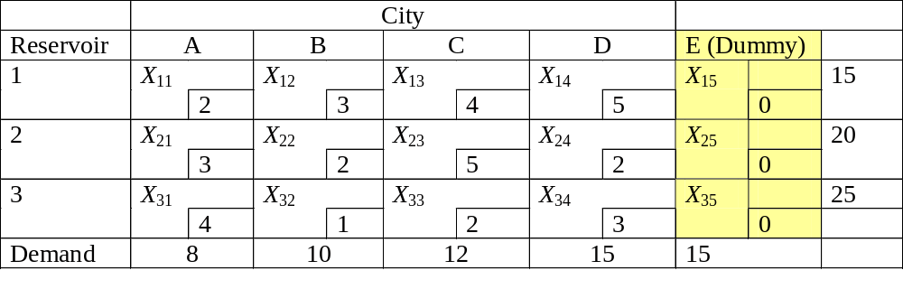
Dealing with Unbalanced Problems
Example: We have three reservoirs with daily supplies of 15, 20, and 25 million liters of fresh water, respectively. On each day we must supply four cities- A, B, C and D, whose demands are 8, 10, 12, and 15, respectively. The cost of pumping per million liters is given below:
Set up the transportation Tableau to determine the cheapest pumping schedule if excess water can be disposed of at no cost.
Dummy Destination Added

Slide 26
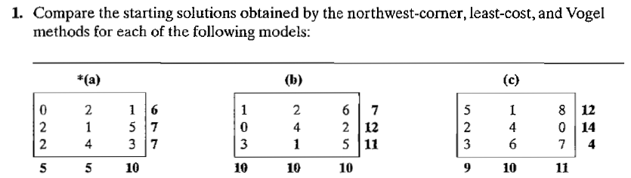
Tutorial

Slide 27
Iterative computation of the transportation algorithms
After determining the starting solution; use the following algorithms to determine the optimum solution
Step1 : use the simplex optimality condition to determine the Entering Variables as the current nonbsic variable that can improve the solution. If the optimality condition is satisfied, stop. Otherwise, go to step 2
Step 2: determine the Leaving variables using the simplex feasibility condition. Change the basis, and return to step 1.
The optimality and feasibility do not involve the row operational that used in simplex method. Instead, the special structure of transportation allow simpler computation

Slide 28
Iterative computation of the transportation algorithms
The determination of the Entering variable is done by computing the nonbasic coefficient in z-row , using Method of multipliers
In the method of multiplier, associate the multipliers ui and vj with row i and column j of the transportation tubule.
These multipliers satisfy the following equations:
ui + vj = Cij, for each basic Xij
To solve these equation, the method of multipliers call for arbitrarily setting any ui=0, and then solving for the remaining variables

Slide 29
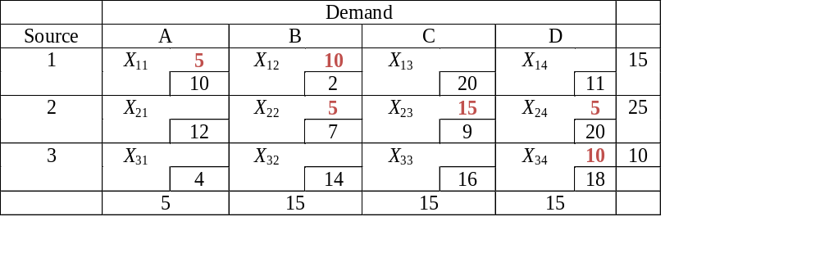
Example
By using the NW corner rule, the starting basic solution are:

Slide 30
Example
Basic variable | (u,v) Equation | Solution
X11 | U1 + V1= 10 | Set U1=0 → V1=10
X12 | U1 + V2 = 2 | U1=0 → V2=2
X22 | U2 + V2 = 7 | V2= 2 → U2= 5
X23 | U2 + V3 = 9 | U2= 5 → V3= 4
X24 | U2 + V4 = 20 | U2= 5 → V4= 15
X34 | U3 + V4 = 18 | V4= 15 → U3= 3
We got: U1=0, U2= 5, U3= 3
V1= 10, V2= 2, V3= 4, V4= 15

Slide 31
Example
Use ui, vi to evaluate the nonbasic variable by computing:
Ui+ vj – cij, for each nonbasic xij
Nonbasic variable | Ui+Vj- cij
X13 | U1+V3-C13= 0+4 -20= -16
X14 | U1+V4-C14= 0+15-11= 4
X21 | U2+V1-C21=5+10-12=3
X31 | U3+V1-C31=3+10-4=9
X32 | U3+V2-C32=3+2-14=-9
X33 | U3+V3-C33=3+4-16=-9

Slide 32
Example
ui+vi-cij=0 for each basic xij is important to computing the z-row of the simplex tubule, as the following:
The transportation seek to minimize so, EV is the largest positive value coefficient in z-row thus X31 is EV
Basic | X11 | X12 | X13 | X14 | X21 | X22 | X23 | X24 | X31 | X32 | X33 | X34
Z | 0 | 0 | -16 | 4 | 3 | 0 | 0 | 0 | 9 | -9 | -9 | 0
Basic | X11 | X12 | X13 | X14 | X21 | X22 | X23 | X24 | X31 | X32 | X33 | X34
Z | 0 | 0 | -16 | 4 | 3 | 0 | 0 | 0 | 9 | -9 | -9 | 0

Slide 33
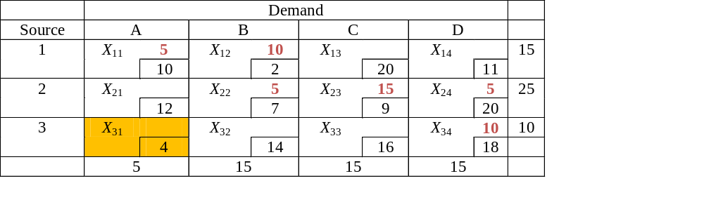
Example
Construct closed loop that start and end at EV;
  The loop consist of connected horizontal and vertical segments only.
  Except EV, each corner must coincide with basic variable.
  It must alternate between subtracting and adding (an addition to one cell in the loop is followed by a subtraction from the next cell in the loop)
-
+
-
+
+
-
each unit shipped here will save $9

Slide 34
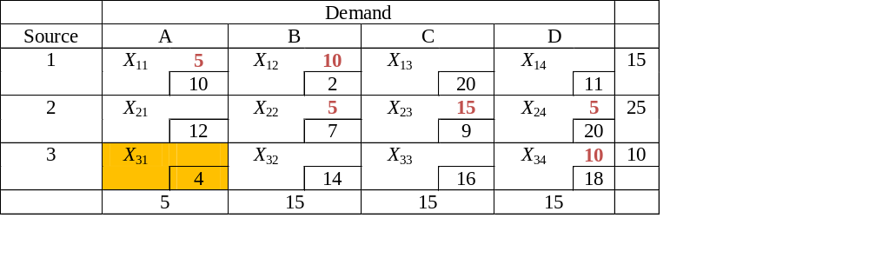
Example
To determine the LV it should Determine Which Current Basic Variable Reaches 0 First.
  If we add one unit to X31, it must subtract a unit from X34 (leaving 9); add it back to X24 (giving 6), and subtract it from X22 (leaving 4); add it back to X12 (giving 11), and subtract it from X11 (leaving 4); this saves (1)($9).
  If we add five unit to X31, it must subtract a 5 unit from X34 (leaving 5); add it back to X24 (giving 10), and subtract it from X22 (leaving 0); add it back to X12 (giving 15), and subtract it from X11 (leaving 0); this saves (5)($9)= $45.
-
+
-
+
+
-
Both X11, X22 reach zero, arbitrary choose X11 to leave the solution
The new cost is 520- 45= $475

Slide 35
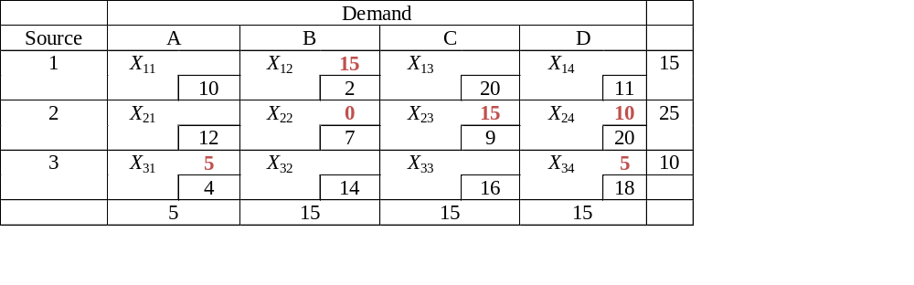
Example
The next transportation tableau is
Basic variable | (u,v) Equation | Solution
X12 | U1 + V2 = 2 | Set U1=0 → V2=2
X22 | U2 + V2 = 7 | V2= 2 → U2= 5
X23 | U2 + V3 = 9 | U2= 5 → V3= 4
X24 | U2 + V4 = 20 | U2= 5 → V4= 15
X34 | U3 + V4 = 18 | V4= 15 → U3= 3
X31 | U3 + V1= 4 | U3= 3 → V1= 1

Slide 36
Example
Use ui, vi to evaluate the nonbasic variable by computing:
Ui+ vj – cij, for each nonbasic xij
Nonbasic variable | Ui+Vj- cij
X11 | U1+V1-C11=0+1-10= -9
X13 | U1+V3-C13= 0+4 -20= -16
X14 | U1+V4-C14= 0+15-11= 4
X21 | U2+V1-C21=5+1-12= -6
X32 | U3+V2-C32=3+2-14= -9
X33 | U3+V3-C33=3+4-16= -9

Slide 37
Example
EV is
closed loop
Basic | X11 | X12 | X13 | X14 | X21 | X22 | X23 | X24 | X31 | X32 | X33 | X34
Z | -9 | 0 | -16 | 4 | -6 | 0 | 0 | 0 | 0 | -9 | -9 | 0
  If we add 10 unit to X14, it must subtract a 10 unit from X24 (leaving 0); add it back to X22 (giving 10), and subtract it from X12 (leaving 5; this saves (10)($4)= $45.
-
+
+
-
X24 reach zero, so it leaves the solution
The new cost is 475- 40= $435

Slide 38
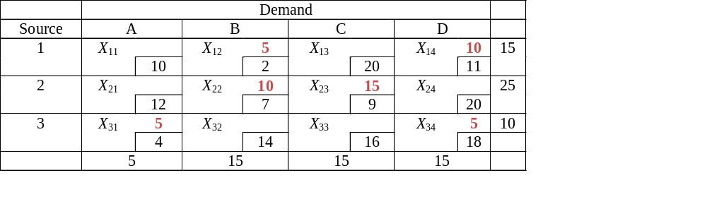
Example
The next transportation tableau is
Basic variable | (u,v) Equation | Solution
X12 | U1 + V2 = 2 | Set U1=0 → V2=2
X14 | U1 + V4 = 11 | U1= 0 → V4 = 11
X22 | U2 + V2 = 7 | V2= 2 → U2= 5
X23 | U2 + V3 = 9 | U2= 5 → V3= 4
X34 | U3 + V4= 18 | V4= 11→ U3= 7
X31 | U3 + V1= 4 | U3= 7 → V1= -3

Slide 39
Example
Use ui, vi to evaluate the nonbasic variable by computing:
Ui+ vj – cij, for each nonbasic xij
Nonbasic variable | Ui+Vj- cij
X11 | U1+V1-C11=0-3-10= -13
X13 | U1+V3-C13= 0+4 -20= -16
X21 | U2+V1-C21=5-3-12= -10
X32 | U3+V2-C32=7+2-14= -5
X33 | U3+V3-C33=7+4-16= -5
X24 | U2+V4-C24=5+11-20=-4

Slide 40
Example
Since no positive , the optimal solution is
Optimal cost is $435
Basic | X11 | X12 | X13 | X14 | X21 | X22 | X23 | X24 | X31 | X32 | X33 | X34
Z | -13 | 0 | -16 | 0 | -10 | 0 | 0 | -4 | 0 | -5 | -5 | 0
From Silo | To mill | Number truckload
1 | 2 | 5
1 | 4 | 10
2 | 2 | 10
2 | 3 | 15
3 | 1 | 5
3 | 4 | 5

